Slide 1
Ethics and dynamics in Human-AI relationships: a cyberpsychological inquiry
</
/>
December 1, 2023

Slide 2
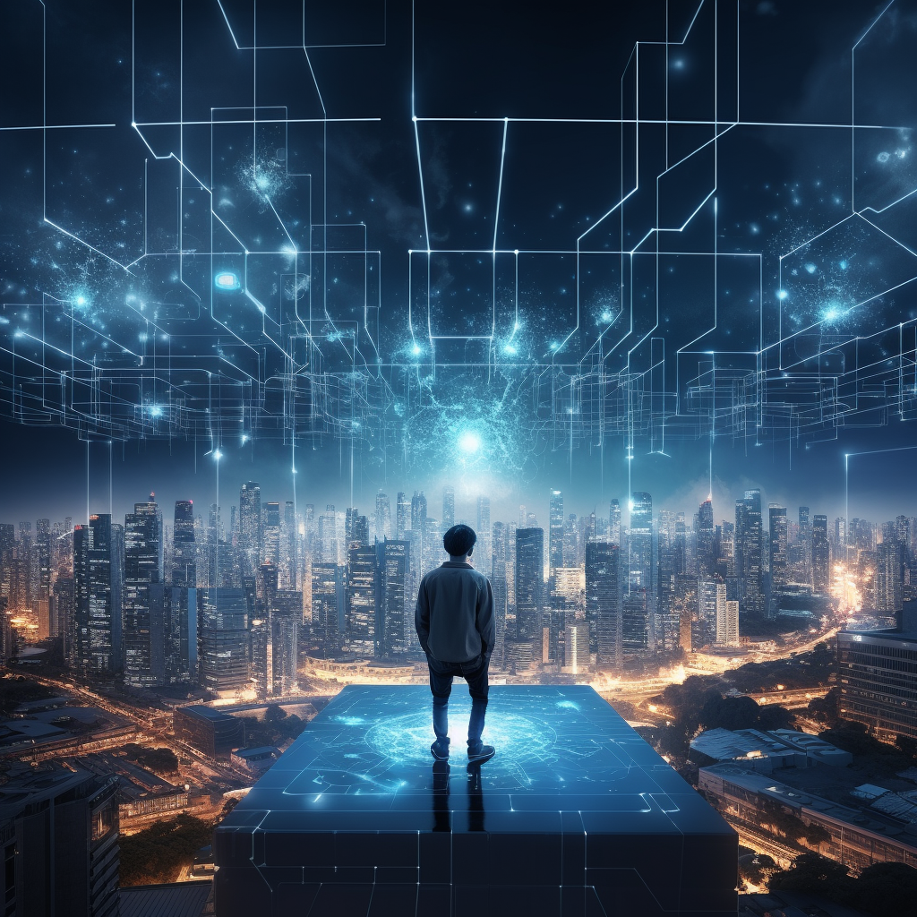
</Valērijs Dombrovskis
Director of the bachelor’s program “Business Psychology” at the RISEBA University of Applied Sciences
Founder & President of Latvian Association of Cyberpsychology
Author of the book 'Cyber Me. All about the Cyberworld' in 2021

Slide 3
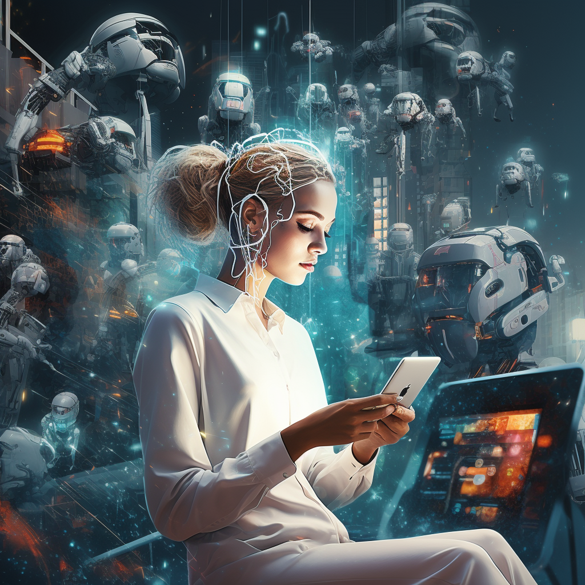
</The Rise of AI and Its Integration
AI's integration into our daily lives is fundamental in the digital age.
It commences with the need for digital authentication.
The digital transformation is increasingly AI-driven.

Slide 4
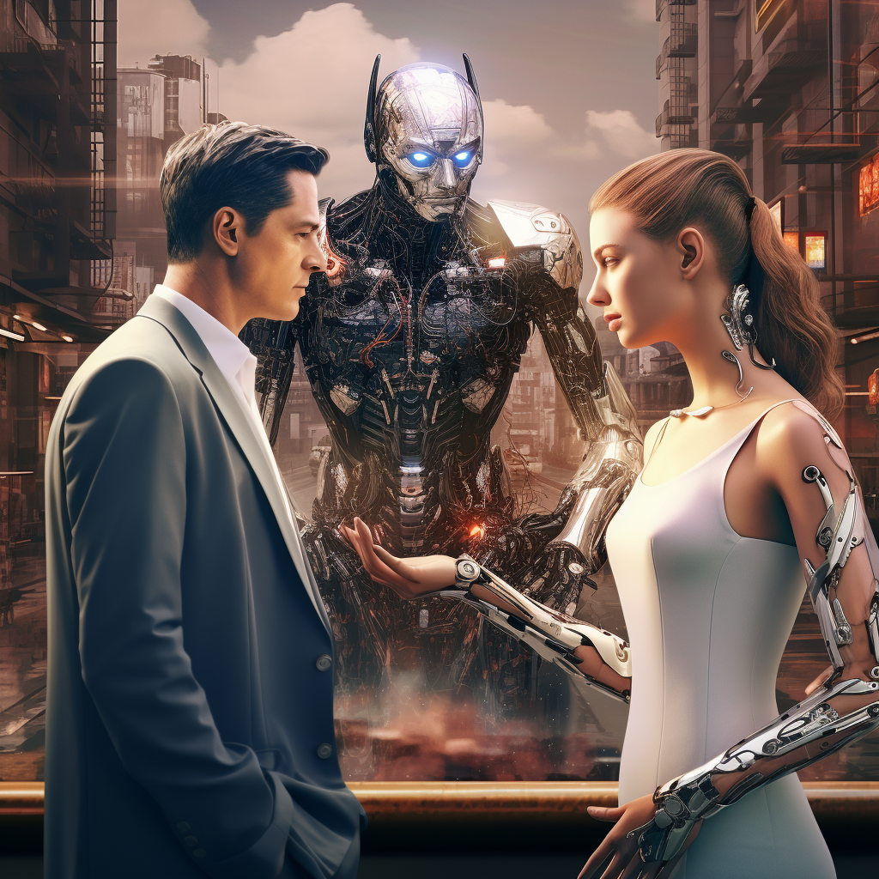
</Defining AI
Bots
Short for 'robots,' these are automated programs designed to perform actions based on specific algorithms, intended for human interfaces.
AI
An amalgamation of algorithms that mimic human actions and thought processes.
Generative AI
A set of algorithms that replicate human actions and thinking to generate content.

Slide 5
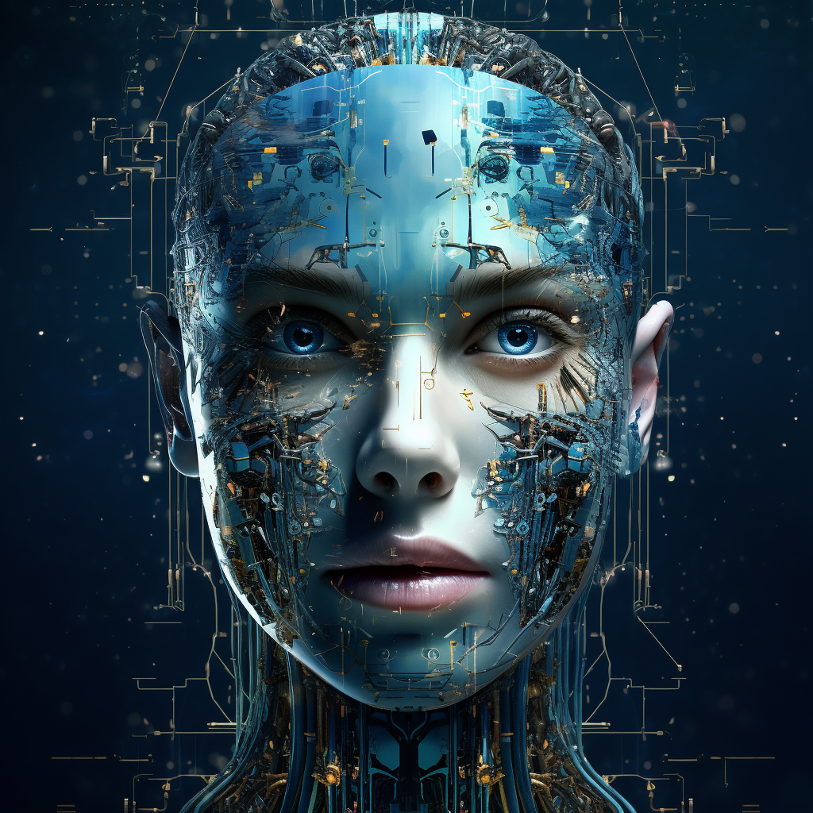
</The Humanization of AI and Understanding
{Broad definitions}
Broad and inclusive definitions of AI open the door to more human-like interactions.
{Perception and interaction}
{Influence on development}
How we perceive and interact with AI is shaped by our understanding of what constitutes a 'artificial intelligence'.
A wide understanding of AI influences how developers design AI systems, blurring the lines between a simple program and true AI.

Slide 6
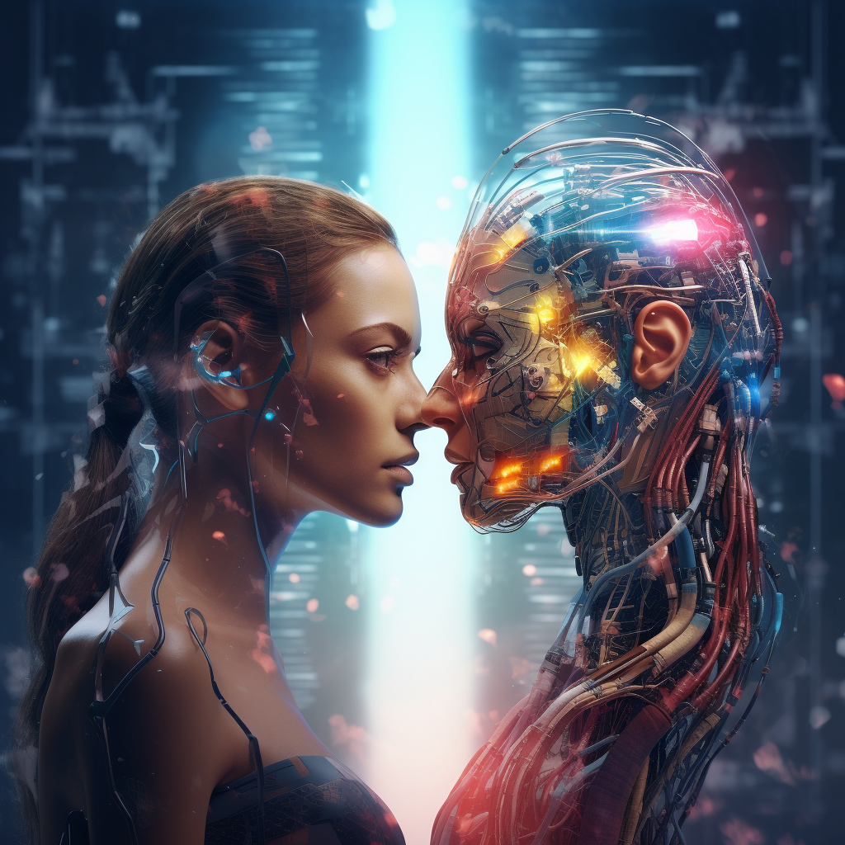
</Blurring Human-AI Lines
AI mimics human behaviors, such as answering questions, recognizing emotions, and creating content.
1
AI technologies that mimic human behaviors include chatbots, facial recognition systems, and deepfake technology.
2
This blurring raises ethical concerns about authenticity and the potential for AI to deceive or manipulate.
3

Slide 7
</Social factors
Perception
Society often distinguishes between AI and human actions.
Engagement
Cognitive biases and emotions influence AI interactions.
Influence
Psychological factors, like fear and privacy concerns, impact AI acceptance.

Slide 8
</Individual Factors
Aligning with societal desires
{01}
{02}
Mimicking living beings
{03}
Responding to user actions
Emotional expression
{04}
{4.1}
Exhibits intentions
Possesses imperfections
{4.2}
{4.3}
Can evoke care
{4.4}
{4.5}
Is accepting
Is engaging

Slide 9
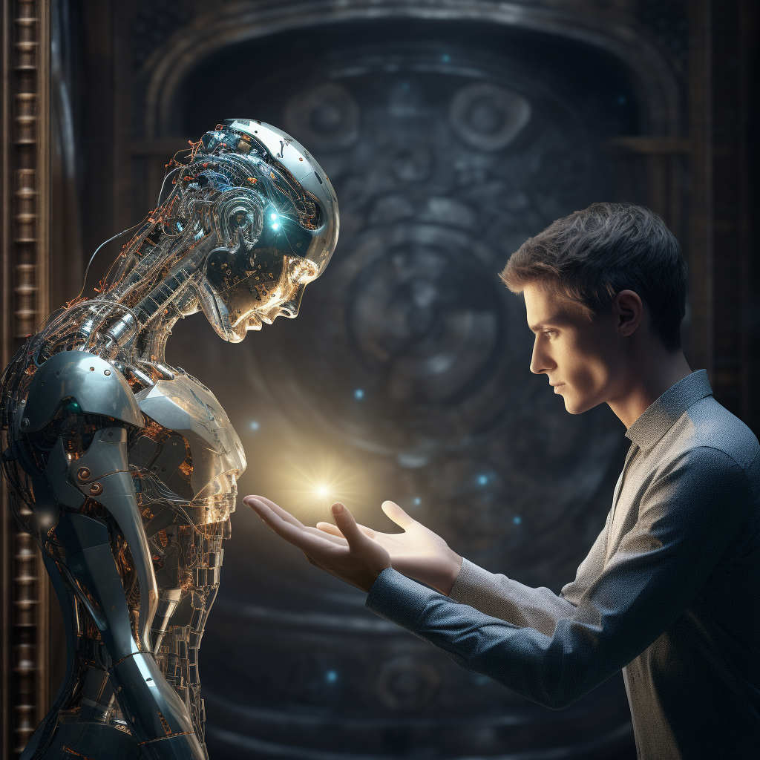
</Is it normal to feel against AI?

Slide 10
</Can AI be trusted?
Problem
Process
Solution
{01}
{02}
{02}
Transparency
Reliability
Ethics

Slide 11
</Conclusion
Key Points
Takeaway
Understanding the evolving dynamics of AI and its integration into our lives
The impact of humanization and blurred lines between human and AI responses
Societal and psychological factors influencing human-AI relationships
The importance of trust in AI based on transparency, reliability, and ethics
The complexities of human-AI relationships require a comprehensive understanding of the various factors at play
Recognizing the impact of humanization and blurred lines between human and AI responses
Considering societal and psychological factors in AI acceptance and interaction
Understanding individual perceptions and how they shape the interaction with AI

Slide 12
</Thank you for your attention
valerijs.dombrovskis@kiberprats.lv
https://www.kiberprats.lv/
+37127003584

